Slide 1
CareCover
Converting complex health insurance policies into actionable coverage clarity, out-of-pocket cost predictability, and real-time care navigation.
· Sohan Saha · Shubhayu Bhattacharya · Shalvi Sukriti

Slide 2








1. Problem Statement & Severity Impact
Dense Policy Legalities & Hidden Clauses
Policyholders struggle to decipher complex terms like 1% sum insured room rent caps, 10-30% co-payments, disease-specific waiting periods, and mandatory pre-authorization timelines.
42%
Proportionate Deduction Traps
Selecting a room category slightly higher than the capped rate scales down surgeon fees, ICU costs, and nursing charges proportionately, creating catastrophic bill shocks.
Average Out-of-Pocket Expense Shock During Emergencies
Driven by hidden room rent caps, mandatory co-pay, and proportionate deduction clauses buried across 30+ pages of policy legal jargon.
Opaque Network Hospitals & Claim Delays
Lack of real-time visibility into nearby cashless network hospitals with available rooms forces post-discharge reimbursement claims, leading to prolonged disputes and high rejection rates.

Slide 3



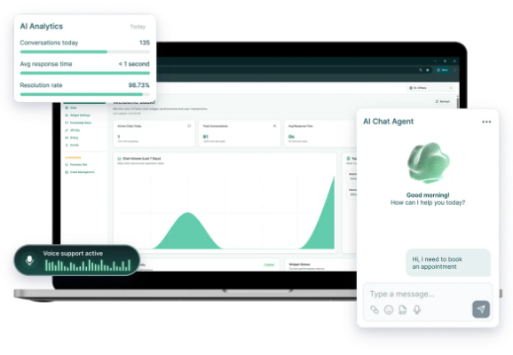



2. Proposed Solution: CareCover
RAG Policy Engine with Citation
Extracts sum insured, room rent capping, co-pay rules, and waiting periods with direct page-level citations for zero hallucinations.
Room Rent & Deduction Simulator
Simulates expected room charges against policy limits to calculate true out-of-pocket costs prior to hospital check-in.
Geo Cashless Network Map
Locates nearby cashless network hospitals with real-time distance, insurer compatibility, and specialty filtering.
Vernacular Multilingual Voice/Text
Provides plain-English and local language explanations to democratize insurance access across diverse patient demographics.

Slide 4



3. Uniqueness, Comparison & Pros/Cons
Solution Differentiation
Relevant Pros & Cons
Unlike traditional insurance brokers (biased, slow, manual) or generic LLM chatbots (prone to legal hallucinations), CareCover Copilot provides verifiable evidence-backed intelligence.
Key Advantages (Pros):
Zero financial bill shock prior to hospital admission.
Exact page-numbered source references build legal trust.
Feature Generic LLM CareCover Copilot
Empowers non-English speaking patients with localized audio.
Page Citation No Yes (Verified)
Limitations & Mitigations (Cons):
Deduction Math Inaccurate Deterministic
Cashless Geo Map None Real-time API
Scanned Physical Policy PDFs: Resolved via Tesseract OCR engine integration.
Non-binding Disclaimer: Clear legal notice that final approvals rest with insurer TPAs.

Slide 5



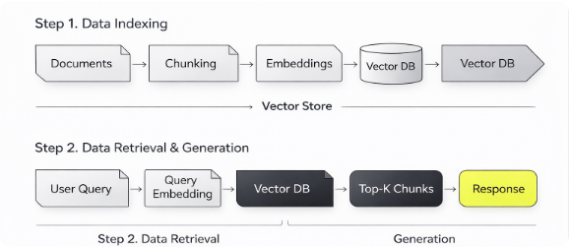



4. Additional Info, References & Architecture
Ingestion Pipeline
Vector Indexing & RAG
Parses structured text and tables from multi-page insurance policy documents and rider schedules.
Generates dense semantic embeddings for context retrieval with metadata tracking (page numbers & clauses).
Deduction & Risk Engine
Application & Geo Layer
Deterministic calculator computes room rent scaling, co-pay fractions, and out-of-pocket estimates.
Delivers an intuitive dashboard with interactive hospital mapping and vernacular audio query response.
Repository: github.com/bshubhayu07/carecover-copilot
Demo Video: < 5 Minute Interactive Product Walkthrough Included in github repository

